Slide 1


Markov Decision Processes for Hybrid Probabilistic Hierarchical Planning
Presentation by Hatem Htira
Notes:
Hello everyone , i m going to talk today about my master thesis with the title ,,,, and how we extend chimp Planner to deal with uncertainty

Slide 2
Outline
Background
Hierarchical task network (HTN)
CHIMP
Necessity of conditional probability
Conclusion
Overview
Express Hybrid knowledge
Markov Decision Processes (MDPs)
Challenges & Limitations
Conversion from HTN to MDP
Notes:
In my presentation, we will hv short overview of the general approach of HTN and MDP
Then i will introduce briefly CHIMP planner ,, and here i will tackle the limits and challenges of it then we will describe and compare the caracteristique of HTN and MDP and how we bridge the gap between the both,
After that i will explain the necessity of conditional probability and how to introduce the hybrid knowledge to MDP
And in end we will finish with the expected result and conclusion

Slide 3
Hierarchical task network (HTN)
Hierarchical decomposition of plans .
Focus on high level abstracted actions by structuring them together
HTN decompose into:
Compound tasks are tasks that can be decomposed into simpler tasks, implemented using methods.
Primitive tasks are achieved by actions.
The decomposition continues until the agent reaches primitive actions.
Adress problems that exceed the expressing power of notations like PDDL.
Notes:
So first, we start with HTN
to formalize it :
And here Rather than working from a simple individual actions toward goals as we have with strips,we have Compounds tasks that used to express Different abstracted levels and every high level will be described with sub tasks,
HTN description structure more powerful than the classical planning language as
**Number, data structures,quantifications

Slide 4
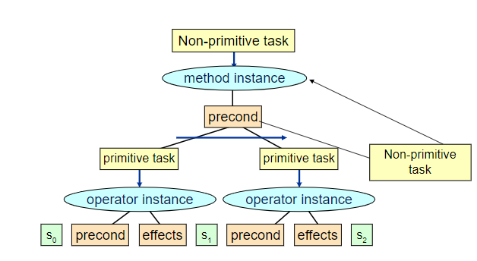
Task Decomposition Strategy
Figure 1: HTN decomposition
Notes:
In this slide, i will explain the the decomposition strategy
we can combine collections of primitive actions that are useful to make complex behavior, instead of focusing on the larger behavior as with the classical planning
The HTN results in a tree like structure where the users navigates from the left to the right
As a demonstration, we could have a method of picking up an object and this action contains two subelements( or primitves tasks) , move_to(table) and then grasp_object,

Slide 5
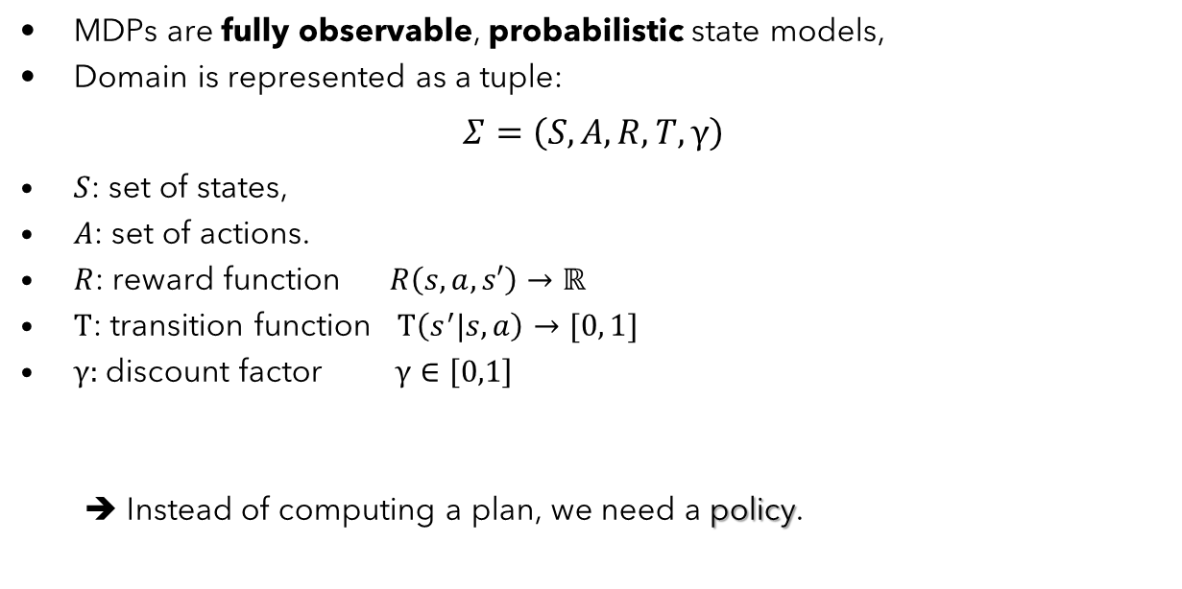
Markov Decision Processes (MDPs)
MDPs are fully observable, probabilistic state models,
Domain is represented as a tuple:
$$Σ=\left(S,A,R,T,γ\right)$$
$S$: set of states,
$A$: set of actions.
$R$: reward function $R\left(s,a,s′\right)→ℝ$
$T$: transition function $T\left(s^{′}|s,a\right)→[0, 1]$
$γ:$discount factor $γ∈\left[0,1\right]$
➔ Instead of computing a plan, we need a policy.
Notes:
I’d like to give you an overview of
initial state is known and fully observable ,
In MDP context, we have a decision maker called agent
interacts with the environment over time→
at each state in this environment, the agent selects actions (based on Observation)
→ and is transitioned into new state and is given a reward as consequence of performing the previous action,
So to formulize it,
actions causes stochastic transitions
describing the reward/cost that the agent receives when it performs action a in state s and ends up in state s’
Policy is a sequence of state’s actions or also called trajectory

Slide 6
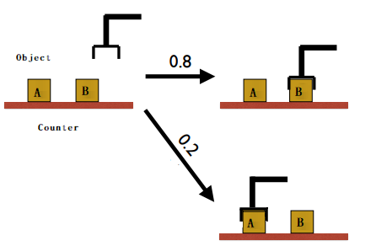
Example
Figure 2: Schematic representation
Notes:
So when we think about MDPs, we need to take account of the uncertainty in the environment,
Here we have non-deterministic actions,
we could consider this example when the agent choose an action A but randomly ends up executing other action and ends up in different state,
In real world environment we hv different things are happening that’s why we need to make decision based on that randomness, as hitting unseen obstacle or sensor failure
We assumre in ur case that the probabilitic transition are determined in advance based on historical data
We express the user preferances and states’s desirability through reward or cost

Slide 7
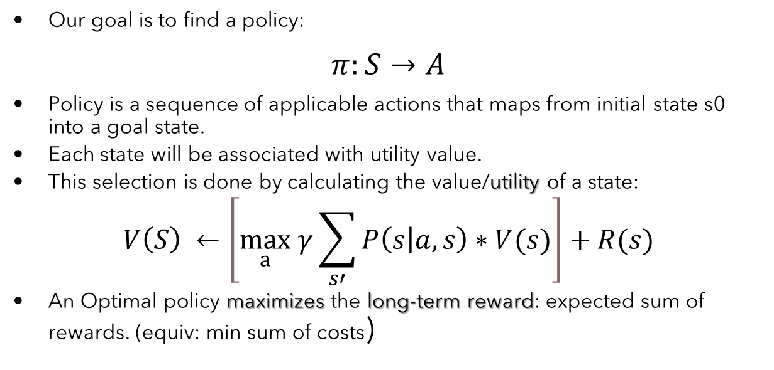
MDPs
Our goal is to find a policy:
$$π:S→A$$
Policy is a sequence of applicable actions that maps from initial state s0 into a goal state.
Each state will be associated with utility value.
This selection is done by calculating the value/utility of a state:
$$V\left(S\right) ←\left[\max_{a} γ\sum_{s′}{P\left(s | a,s\right)∗V(s)}\right]+R(s)$$
An Optimal policy maximizes the long-term reward: expected sum of rewards. (equiv: min sum of costs)
Notes:
Policy generally specifies what the agent should do in any state
The MDP algorithms used to indicates which is the appropriate action to select in order to maximize the long term reward
If this mapping selects the action that leads to the long-term maximum reward, then the policy is optimal

Slide 8
Back to CHIMP (Conflict-driven Hierarchical Meta-CSP Planner)
HTN planning with hybrid reasoning.
Overcome the large hybrid search by extending it with hierarchical task decomposition strategy.
Combine causal knowledge, temporal knowledge and resource.
A CSP-style backtracking search is used to find a temporally and symbolically consistent plan.
➔ Note that CHIMP description does not contain the structure of MDP.
➔ Assumed closed world environment (Predictable world).
Notes:
Hybrid planning will be formulated as meta-csp
The hybrid knowledge will be represented as Constraint Satisfaction Problem,
solution in CHIMP context means we need to hv consistency in every knowledge aspect ( temporal, spatial ,,,)
Or any tools to deal with uncertainty // and all actions are deterministic/predicatble
And this assumption will be relaxed in our work

Slide 9
CHALLENGES & LIMITATIONS
Does not model Uncertainty (no probabilities).
Does not consider a more general models.
Solution:
➔ Combine the existing HTN structure with an MDP solver.
Issues raised:
How can we represent reward and action behaviors in the hierarchical planning (CHIMP)?
How to get all the possible MDP states from HTN?
Why can’t we reject HTN altogether and only use MDPs?
Notes:
How can HTNs be modelled as MDPs?
Similar logic as with CHIMP , we use HTN tp Overcome the large MDP state space

Slide 10
Comparison
Hierarchical Task Network (CHIMP)
States are not enumerated exhaustively.
State consists of properties of the environment.
Each action modifies properties of the environment.
Set of actions induces a smaller state space.
Markov Decision Process
MDP domain explicitly enumerates all relevant states.
Implicitly represent the same properties expressed in HTN state.
MDP solver must consult the entire state space.
Astronomically large: difficult to solve if the problem is very complex (hundreds of state’s variables)
Notes:
In order to convert the HTn domain to MDP, we nee first of all to compare the carateristiques of the both
We combine the both to reduce the search space,

Slide 11
From HTN to MDP
Expansion
Generate States
Generate transition functions
Generate reward function
Notes:
here are (four) different stages to realise the passage from HTN to MDP.
First / then / next / after that
How we get a Fully#Expanded#HTN

Slide 12
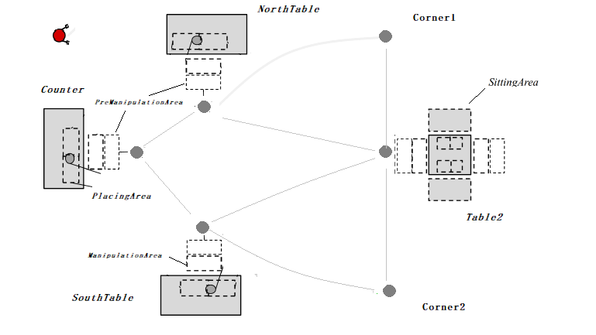
From HTN to MDP (Expansion)
The idea here is to fully expand the HTN domain into graph:
Defined by tasks (vertices) and ordering constraints (edges).
Each primitive task induces a state.
This expansion starts with adding the initial state to the task network.
The failure condition for this algorithm is the same as it is for the HTN planning algorithm.
➔ Obtain a expandable HTN graph that maintains the properties of the plan paths.
Figure 4: Schematic representation
Notes:
Initial states extracted from the problem description
, so if an HTN isn’t solvable, then the resulting MDP will not reach desirable solution

Slide 13
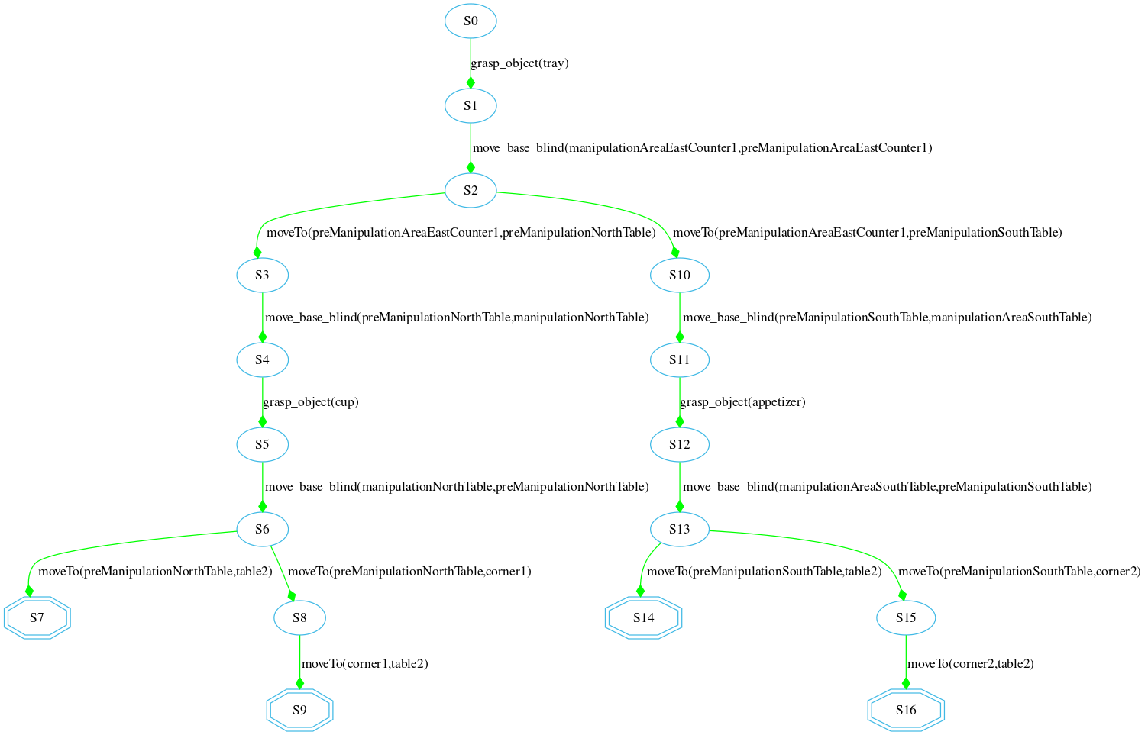
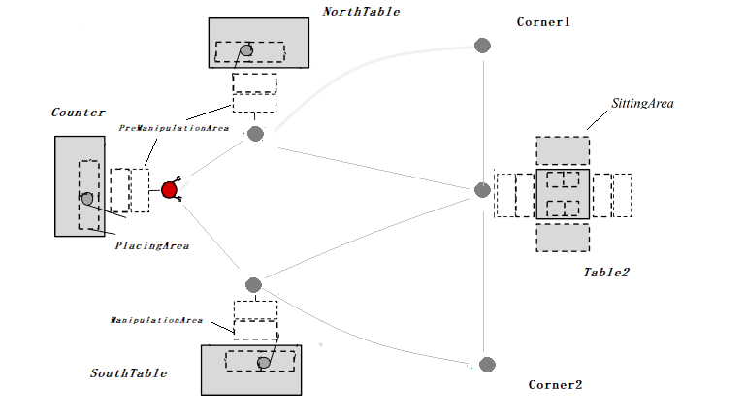
Expansion Examples: drive_robot() (from Counter)
Decompose task through methods in the domain until primitive tasks are reached
Figure 5: Fully decomposed HTN
Notes:
Now we have some demonstration of some expansion results
---
This expansion is generated from domain description, we add the initial state s0
Executing of each task will change the enviornment

Slide 14
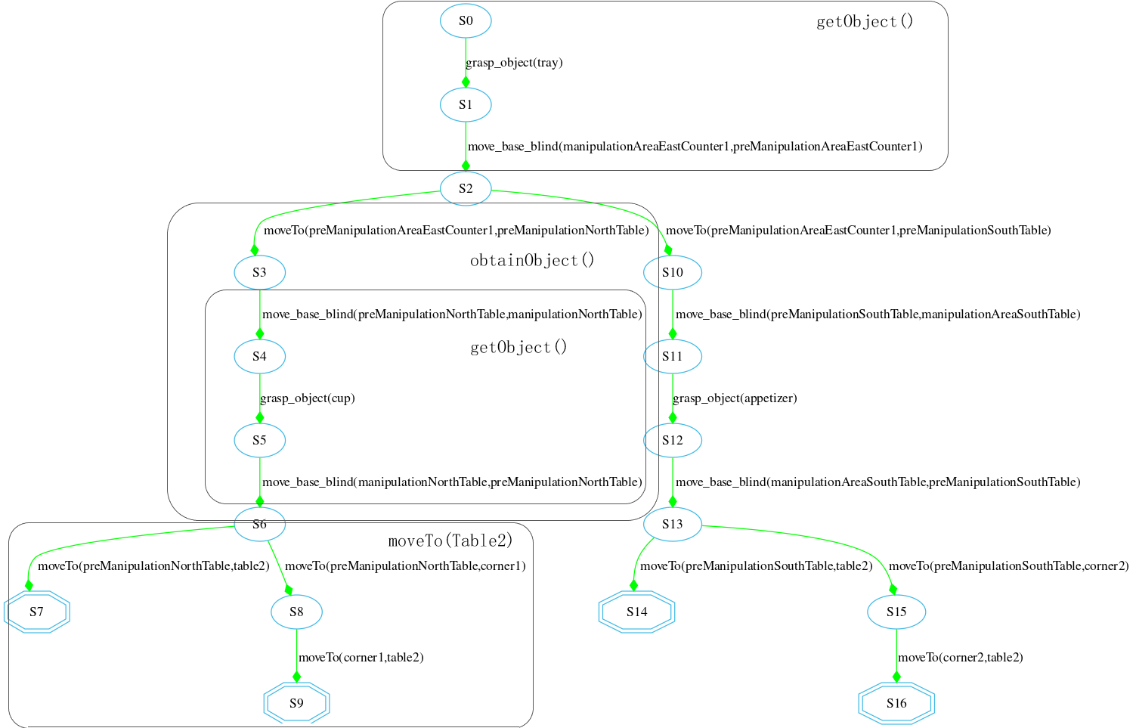
Figure 6: Fully decomposed HTN (with primitive tasks)
Notes:
All the methods will be decomposed until only primitive éléments are left

Slide 15
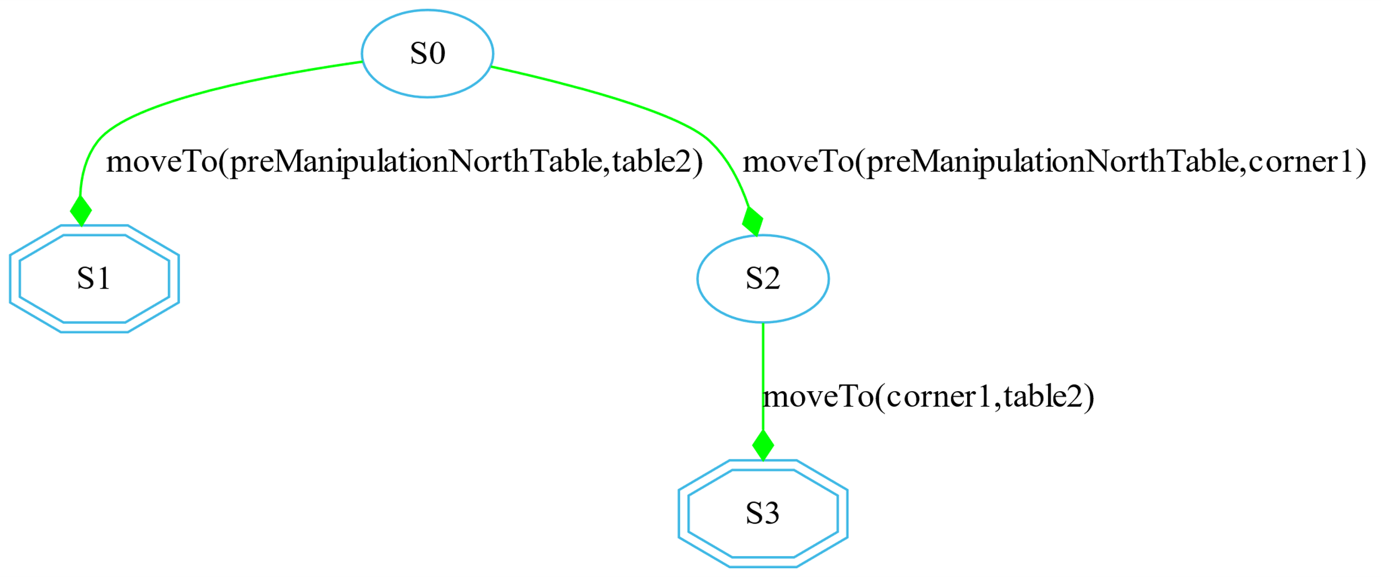
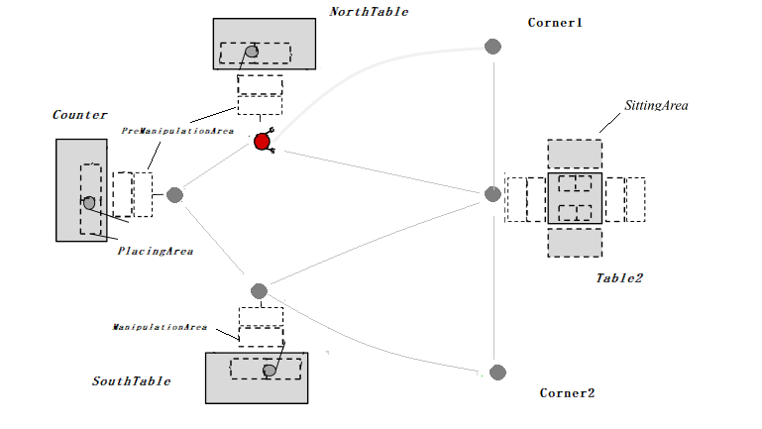
Expansion Examples: drive_robot() (from northTable)
The HTN decompositions depends also on the initial problem description
Figure 7: HTN decomposition from NorthTable
Notes:
We are not required to expand all the defined methods in the domain description , but we decompose only the methods that satisfy the intial state and lead us to the final state
As result, we get only small branch of the previous graph

Slide 16
States Génération
State-Spaces come from the reachable primitive tasks in the fully expanded HTN.
All expanded HTN states will be used as input for MDP solver.
Each primitive task in the fully decomposed HTN is considered to represent the state achieved immediately after executing the action associated with it.
Algorithm must detect the overlapping states (for the transition functions):
Partition them so that there is no ambiguity over the current state for MDP.
Notes:
For mdp consists of non-overlapping states ,
in some scenarios we could have states with the same axioms or features , as an abstract example,

Slide 17
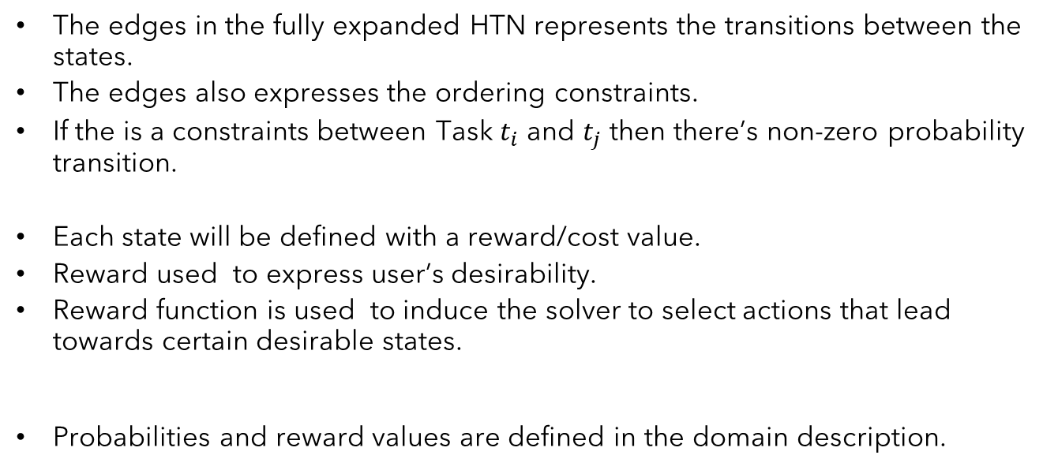
Transition Functions / Reward Génération
The edges in the fully expanded HTN represents the transitions between the states.
The edges also expresses the ordering constraints.
If the is a constraints between Task $t_{i}$ and $t_{j}$ then there’s non-zero probability transition.
Each state will be defined with a reward/cost value.
Reward used to express user’s desirability.
Reward function is used to induce the solver to select actions that lead towards certain desirable states.
Probabilities and reward values are defined in the domain description.

Slide 18
Operator (CHIMP)
(:operator
(Head !pick_up_object(?obj ?arm))
(Pre p1 On(?obj ?fromArea))
(Pre p2 RobotAt(?mArea))
(Pre p3 Holding(?arm ?nothing))
(Del p1)
(Del p3)
(Add e1 Holding(?arm ?obj))
(Constraint During(task,p2))
(Constraint Meets(p4,e1))
(Constraint Duration[4000,INF](task))
(ResourceUsage
(Usage armManCapacity 1)))
Primitive task
Precondition
Effect
Temporal Constraints
Resource fluents

Slide 19
Operator (CHIMP)
(:operator
(Head !pick_up_object(?obj ?arm))
(Pre p1 On(?obj ?fromArea))
(Pre p2 RobotAt(?mArea))
(Pre p3 Holding(?arm ?nothing))
…
(Reward -0,04)
(TransitionProb 0,80)
…
(ResourceUsage
(Usage armManCapacity 1)))
Markovian inputs

Slide 20
The Necessity of Conditional Probability
Not all states has the same reward and transition probability.
Flexibility in assignment markovian parametres for each specific state and task.
Figure 8: HTN decomposition

Slide 21
The Necessity of Conditional Probability
Each primitive task has ist own transition probability,
Distinguish the possible operators through the if-statement.
// move from ?l1 to ?l2
(:operator
(Head !moveTo(?l1 ?l2))
....
(if (Values ?l2 london) (Reward 1)) // final state only reward
(if (Values ?l2 corner1) (Reward -0.06) (TransitionProb 0.8))
(else (Reward -0.04) (TransitionProb 0,7)) // all the other states
(ResourceUsage (Usage Money 30))
)
Comparaison between symbolic arguments
If the boolean expression evaluates to true, a reward and transition probability statements are then executed.
One summarized operator instead of operator for each path
Notes:
An updated form of IF-statements ( IF-THEN and IF-THEN-ELSE )
is implemented and can be used flexibly depending on the usage and
designer planning choice,
Balance between reward and risk

Slide 22
Deal with Diverse Knowledge (Hybrid Planning)
How to express hybrid knowledge in MDP solver?
The markovian parameters will be updated during the parameters generation based on the hybrid knowledge
Only if inconsistency is found
Use the conditional clauses to affect the reward in the inconsistance states
Check resource availability
Apriori defined:
(ResourceUsage (Usage Money 40))
Calculated based on spatial knowledge:
( UnarySpatialFluent sp1 Size ( counter [4,4] [18,18] ))
( UnarySpatialFluent sp2 Size ( table2 [4,4] [18 ,18] ))
( UnarySpatialFluent sp3 At ( Counter [50,50] [54,54] [50,50] [68,68] ))
( UnarySpatialFluent sp4 At ( table1 [72,72] [76,76] [50,50] [68,68] ))
Notes:
Now,we come to the last main part of our thesis
Sevral aspects of hybrid reason are included in our approach
we fetch the remaining resource of the incoming state
Disfavorsie the state

Slide 23
Deal with Diverse Knowledge (Resource Reasoning)
Resource consistency is checked using TCSP solver.
To manage numeric constraints and to detect inconsistencies effectively.
The constraint propagation will be done simultaneous during transition
probability generation.
(if (IC ?Money < 50) (decrease Reward 0.02)
Notes:
In each MDP state, we will fetch the remaining resource

Slide 24
Deal with Diverse Knowledge (Resource Reasoning)
(:operator
(Head !moveTo(?l1 ?l2))
(Pre p1 robotAt(?l1))
(Del p1)
(Add e1 robotAt(?l2))
(if (Values ?l2 table2) (Reward 1)) #table2 always is the final state
(if (Values ?l1 corner1) (Reward 1.2) (TransitionProb 0.9)) #
(if (Values ?l2 corner2) (Reward -0.04) (TransitionProb 0.9)) #
(else (Reward -0.04) (TransitionProb 0.7)) #
(if (IC ?Money < 10) (decrease (Reward 0.22))
(ResourceUsage
(Usage BatteryStorageCapacity 30))
)
Notes:
Decrease the reward of taking this action

Slide 25
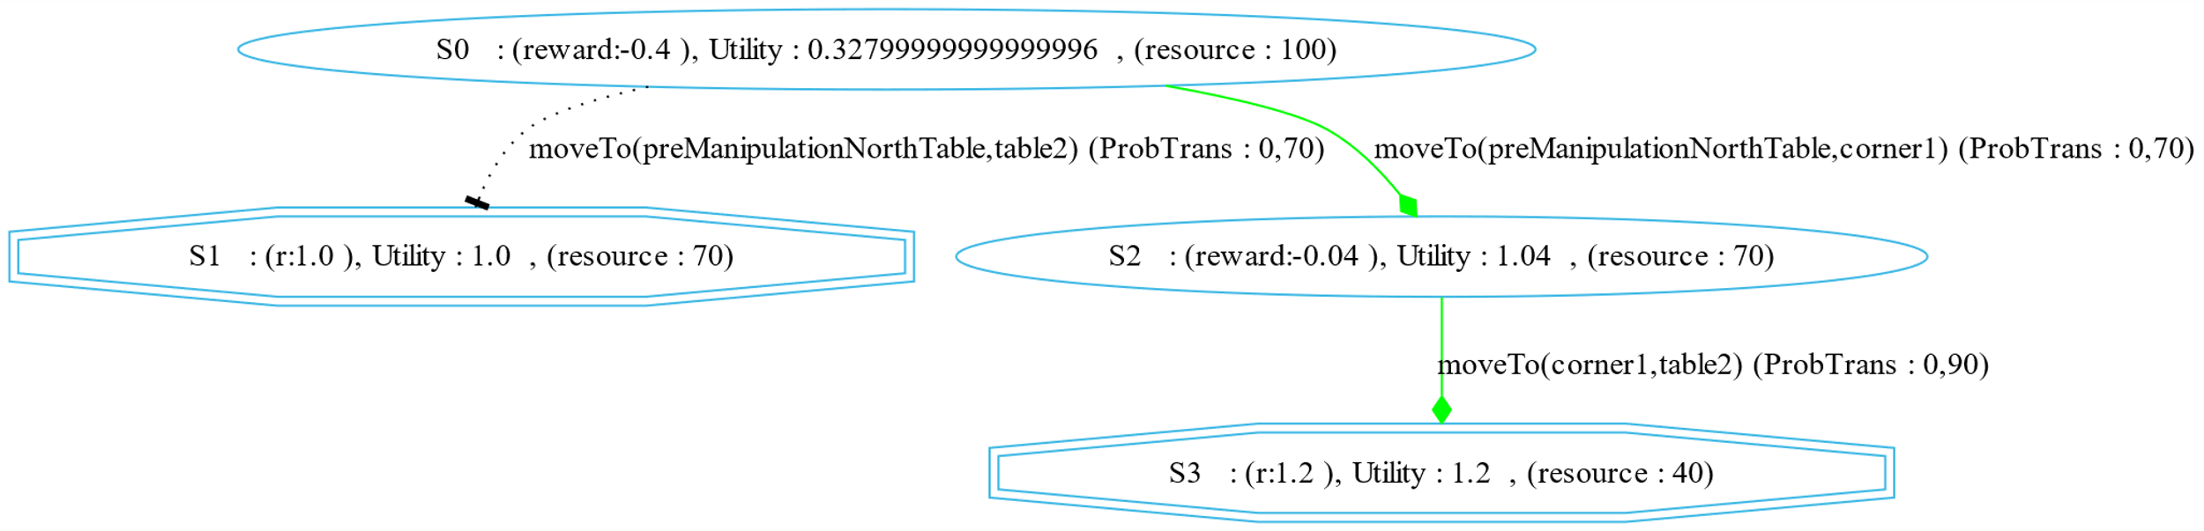
Deal with Diverse Knowledge (Resource Reasoning)
(Resource BatteryStorageCapacity 100)
Figure 9: HTN decomposition of drive_robot(Table2)
*Favorise S3

Slide 26
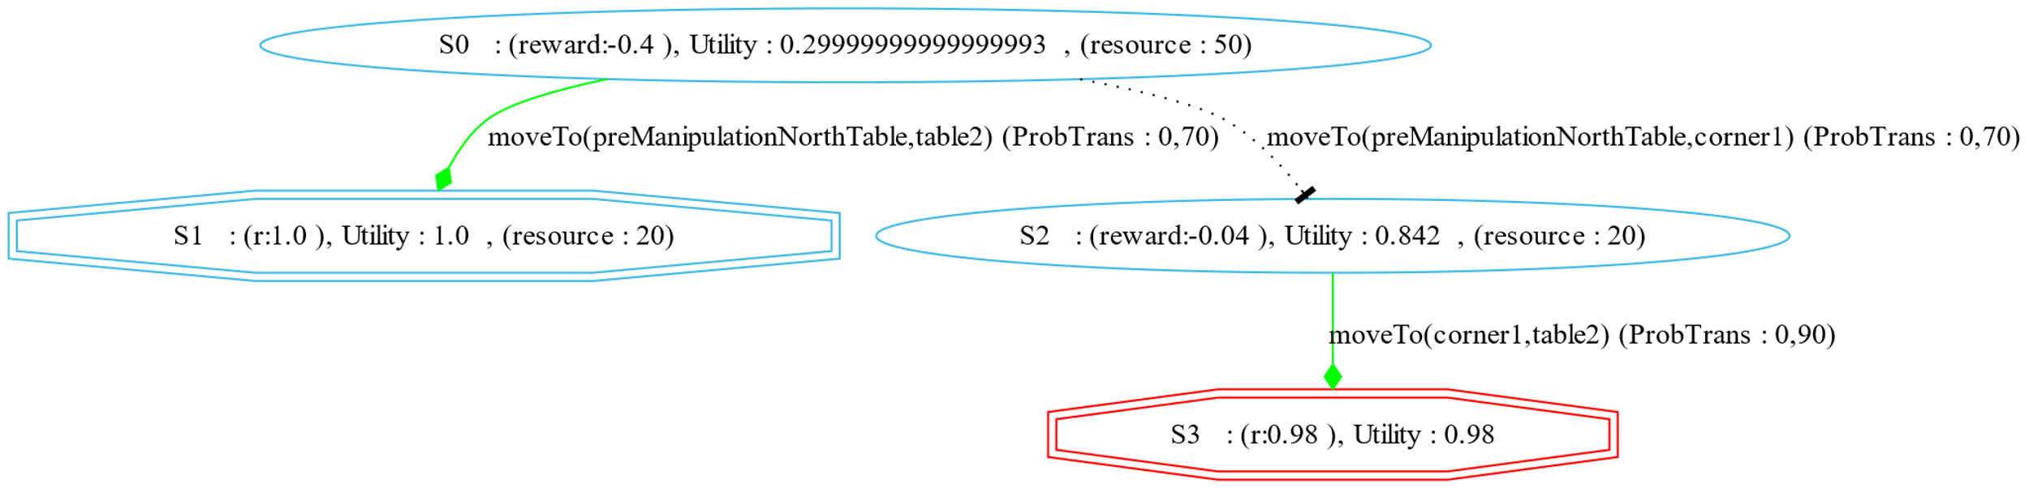
Deal with Diverse Knowledge (Resource Reasoning)
(Resource BatteryStorageCapacity 50)
Figure 9: HTN decomposition of drive_robot(Table2)
*Red octagon indicates inconsistent state
Notes:
All that trajectory will be defavorised
In this case when the long safer trajectory is inconsistent , the risky one will be chosen

Slide 27
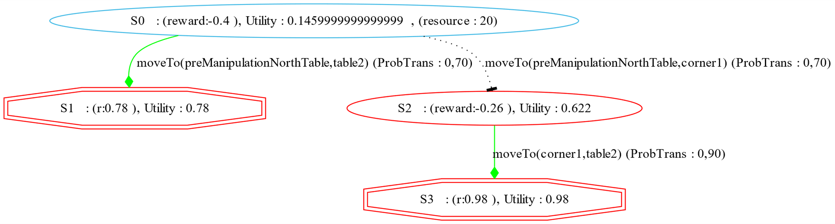
Deal with Diverse Knowledge (Resource Reasoning)
(Resource BatteryStorageCapacity 20)
Figure 9: HTN decomposition of drive_robot(Table2)
*No Solution

Slide 28
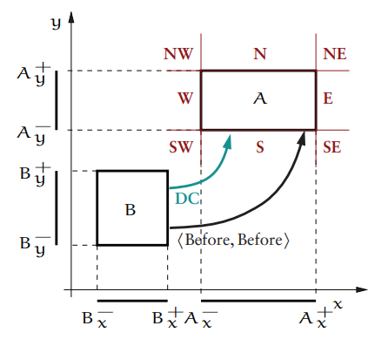
Deal with Diverse Knowledge (Spatial Reasoning)
Unary Constraints:
Size [Lx, Ux], [Ly, Uy]
At [Lx1, Ux1], [Lx2, Ux2], [Ly1, Uy1], [Ly2, Uy2]
Resource usage will be defined by spatial knowledge,
The distance between the two midpoint of the two spatial objects.
The distance between two places, will determine the resource usage,
E,g: 10% reduced each 100U
Figure 10: Rectange Algebra example
*Implemented during the 15 ECTS research project

Slide 29
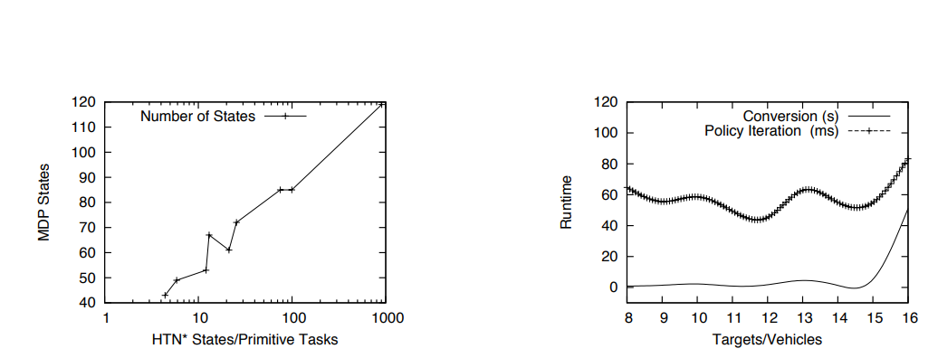
Evaluation (TODO)
Figure 11: : Results of the experiments
* Meneguzzi’s evaluation results
Notes:
For evaluation , I have not reach that point yet, that’s why I will domenstrate shortly the the result of using this approach by the original paper
as the number of primitive tasks in the fully expanded HTN explodes quite quickly, the MDP states resulting from the expansion algorithm grow much more slowly
Second we measured the runtime of the conversion process, as well as the computation of an optimal MDP policy using policy iteration with a discount factor of 1.
The runtimes in the graph of Figure 2b show that, while the conversion process is rather expensive due to the huge size of the HTN state space, the reduced state space led to very efficient MDP encodings which solved by Policy iteration algorithm

Slide 30
Conclusion
Refers mainly to the uncertainty in the planning process, with a simple action error model providing the uncertainty from the world
Maintaining the properties of the plan paths described by the HTN
Include hybrid knowledges in MDP Solver
Conversion process to bridge the gap between HTN and MDP
Extend a hybrid hierarchical task network planner to perform in a stochastic environment.
Notes:
To sum up,
New Approach to deal with uncertainty through
The main limitation is that the MDP probabilities automatically generated by our conversion process refer mainly to the uncertainty in the planning process, with a simple action error model providing the uncertainty from the world, but we envision richer ways of having this information supplied with the input.

Slide 31

Thank You For Your Attention.

Slide 32
Literature
Meneguzzi, F. e. (2011). An approach to generate MDPs using HTN representations." Decision Making in Partially Observable, Uncertain Worlds: Exploring Insights from Multiple Communities,. Barcelona, Spain.
Stock, S. (2017). Hierarchische hybride Planung für mobile Roboter.

